Slide 1
Adventist Discovery Centre

Slide 2
Home Bible Course
USA
Before
WWII

Slide 3
Home Bible Course
USA
The Bible School of the Air
USA
Before
WWII
1942

Slide 4
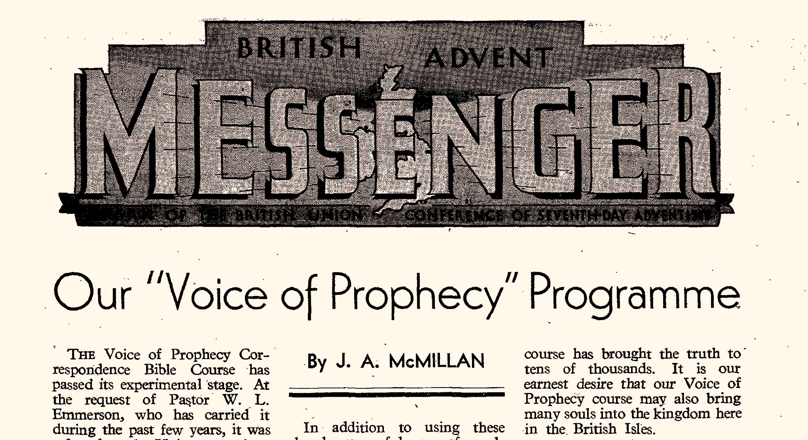
Home Bible Course
USA
The Bible School of the Air
USA
Voice of Prophecy Bible
School
UK
Before
WWII
1942
1945

Slide 5
Home Bible Course
USA
The Bible School of the Air
USA
Voice of Prophecy Bible
School
UK
Adventist Discovery Centre
UK
Before
WWII
1942
1945
1998

Slide 6
WHAT IS THE ADC?

Slide 7
WHAT IS THE ADC?
The ADC is a correspondence school and resources centre.
We offer free distance learning for your discovery journey.

Slide 8
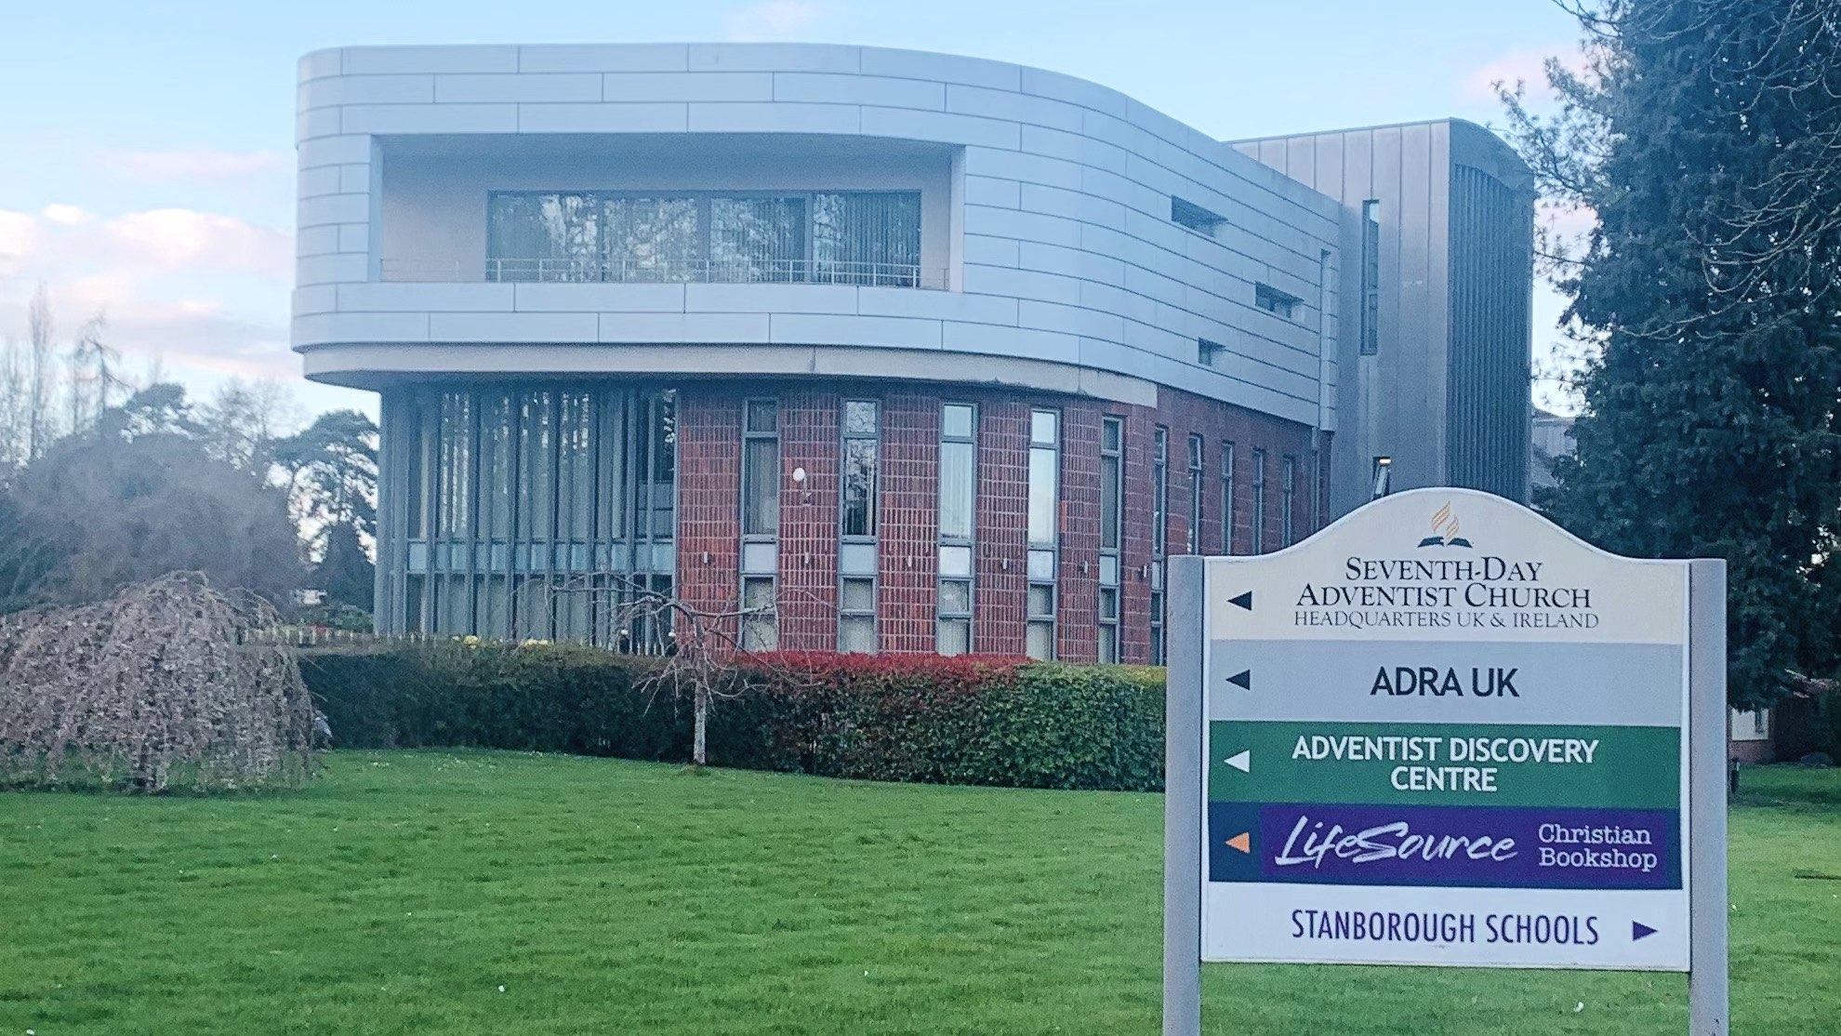

Slide 9
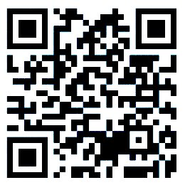
AdventistDiscoveryCentre.org

Slide 10
THE 4 ADC VECTORS
online and mailed courses
articles, books along with other valued digital media resources
the FreeBible programme
social network communities for interactive studies

Slide 11
1. ADC COURSES
Spirituality
Jesus Christ
Faiths/Archaeology
Health
Juniors

Slide 12
2. ADC RESOURCES
Articles
Books
Audio
Video
Hope Channel

Slide 13
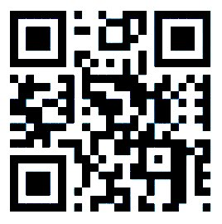
3. FREEBIBLE
FreeBible is a website, www.freebible.uk where a user completes some online quizzes.

Slide 14
3. FREEBIBLE
FreeBible is a website, www.freebible.uk where a user completes some online quizzes.
10 quizzes done get your free Bible!
All 28 quizzes done get a free Desire of Ages (illustrated)

Slide 15
THE 4 ADC VECTORS
online and mailed courses
articles, books along with other valued digital media resources
the FreeBible programme
social network communities for interactive studies

Slide 16
4. ADC COMMUNITIES
Social network communities for interactive studies:
Churches
Small groups
Communities

Slide 17
WAYS to interact

Slide 18
WAYS to interact
Small group in the church
Weekly prayer and Bible study meetings
Baptismal classes
Discipleship / Pathfinders / Continual education
Campaign in the community
Mission wide study meetings (Zoom)

Slide 19
WAYS to GET INVOLVED

Slide 21
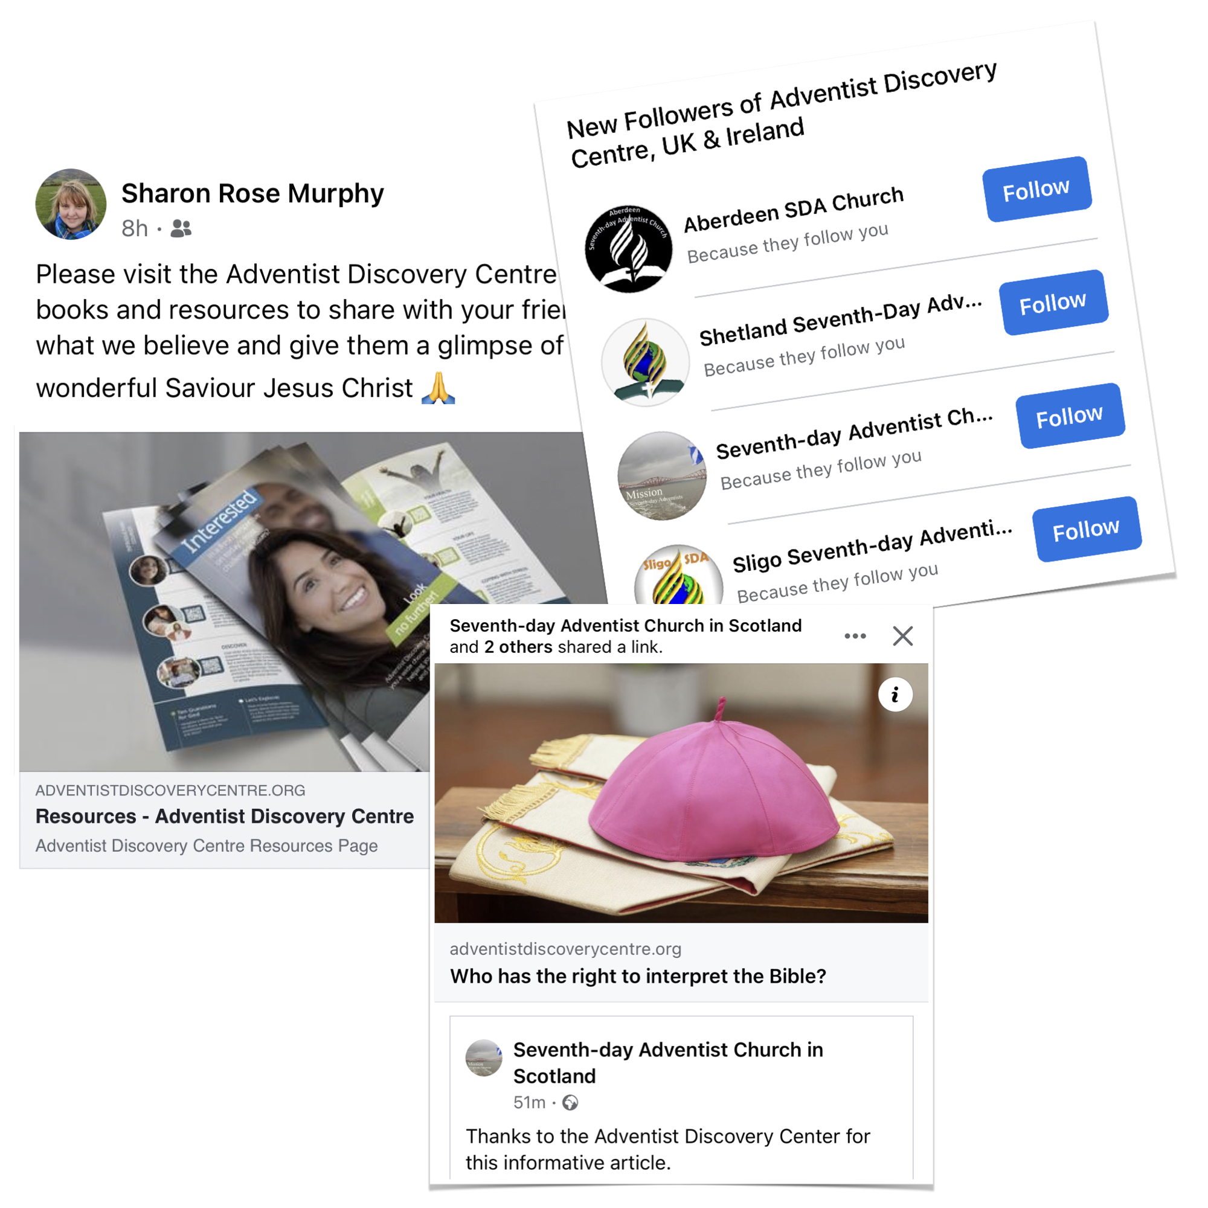

Slide 22
Journey

Slide 23
Journey
Advertisement

Slide 24
Journey
Advertisement
Student registration

Slide 25
Journey
Advertisement
Student registration
Completion of FreeBible / Course

Slide 26
Journey
Advertisement
Student registration
Completion of FreeBible / Course
Follow up with other courses (resources)

Slide 27
Journey
Advertisement
Student registration
Completion of FreeBible / Course
Follow up with other courses (resources)
Questions about church

Slide 28
Journey
Advertisement
Student registration
Completion of FreeBible / Course
Follow up with other courses (resources)
Questions about church
Visit to/from the church

Slide 29
Inspiration
God might have committed the message of the gospel, and all the work of loving ministry, to the heavenly angels. He might have employed other means for accomplishing His purpose. But in His infinite love He chose to make us co-workers with Himself, with Christ and the angels, that we might share the blessing, the joy, the spiritual uplifting, which results from this unselfish ministry.
(Ellen White, Steps to Christ)

Slide 30
Inspiration
God might have committed the message of the gospel, and all the work of loving ministry, to the heavenly angels. He might have employed other means for accomplishing His purpose. But in His infinite love He chose to make us co-workers with Himself, with Christ and the angels, that we might share the blessing, the joy, the spiritual uplifting, which results from this unselfish ministry.
(Ellen White, Steps to Christ)

Slide 31
Inspiration
God might have committed the message of the gospel, and all the work of loving ministry, to the heavenly angels. He might have employed other means for accomplishing His purpose. But in His infinite love He chose to make us co-workers with Himself, with Christ and the angels, that we might share the blessing, the joy, the spiritual uplifting, which results from this unselfish ministry.
(Ellen White, Steps to Christ)

Slide 35
Let’s go together!

