Slide 1
Mission at your fingertips
Pastor Christian Salcianu Adventist Discovery Centre UK and Ireland

Slide 2
‘Salvation is from the Jews.’

Slide 3
‘Salvation is from the Jews.’
(John 4:22)

Slide 4
‘Jews do not associate with Samaritans.’
(John 4:9)

Slide 5
HOW WILL THE GOSPEL EVER REACH SAMARITANS?

Slide 6
The Great Commission

Slide 7
“Go and make disciples of all nations, baptising them in the name of the Father and of the Son and of the Holy Spirit, and teaching them to obey everything I have commanded you.”
MATTHEW28

Slide 8
“Go and make disciples of all nations, baptising them in the name of the Father and of the Son and of the Holy Spirit, and teaching them to obey everything I have commanded you.”
MATTHEW28

Slide 9
“Go and make disciples of all nations, baptising them in the name of the Father and of the Son and of the Holy Spirit, and teaching them to obey everything I have commanded you.”
MATTHEW28
MARK16

Slide 10
“Go and make disciples of all nations, baptising them in the name of the Father and of the Son and of the Holy Spirit, and teaching them to obey everything I have commanded you.”
MATTHEW28
“Go into all the world and preach the gospel to all creation. […] And these signs will accompany… drive out demons; speak in new tongues; pick up snakes; deadly poison will not hurt at all; place their hands on sick people, and they will be healed.”
MARK16

Slide 11
“Go and make disciples of all nations, baptising them in the name of the Father and of the Son and of the Holy Spirit, and teaching them to obey everything I have commanded you.”
MATTHEW28
“Go into all the world and preach the gospel to all creation. […] And these signs will accompany… drive out demons; speak in new tongues; pick up snakes; deadly poison will not hurt at all; place their hands on sick people, and they will be healed.”
MARK16

Slide 12
“Go and make disciples of all nations, baptising them in the name of the Father and of the Son and of the Holy Spirit, and teaching them to obey everything I have commanded you.”
MATTHEW28
“Go into all the world and preach the gospel to all creation. […] And these signs will accompany… drive out demons; speak in new tongues; pick up snakes; deadly poison will not hurt at all; place their hands on sick people, and they will be healed.”
MARK16
LUKE24

Slide 13
“Go and make disciples of all nations, baptising them in the name of the Father and of the Son and of the Holy Spirit, and teaching them to obey everything I have commanded you.”
MATTHEW28
“Go into all the world and preach the gospel to all creation. […] And these signs will accompany… drive out demons; speak in new tongues; pick up snakes; deadly poison will not hurt at all; place their hands on sick people, and they will be healed.”
MARK16
“Repentance for the forgiveness of sins will be preached in [Christ’s] name to all nations, beginning at Jerusalem.”
LUKE24

Slide 14
“Go and make disciples of all nations, baptising them in the name of the Father and of the Son and of the Holy Spirit, and teaching them to obey everything I have commanded you.”
MATTHEW28
“Go into all the world and preach the gospel to all creation. […] And these signs will accompany… drive out demons; speak in new tongues; pick up snakes; deadly poison will not hurt at all; place their hands on sick people, and they will be healed.”
MARK16
“Repentance for the forgiveness of sins will be preached in [Christ’s] name to all nations, beginning at Jerusalem.”
LUKE24

Slide 15
“Go and make disciples of all nations, baptising them in the name of the Father and of the Son and of the Holy Spirit, and teaching them to obey everything I have commanded you.”
MATTHEW28
“Go into all the world and preach the gospel to all creation. […] And these signs will accompany… drive out demons; speak in new tongues; pick up snakes; deadly poison will not hurt at all; place their hands on sick people, and they will get well.”
MARK16
“Repentance for the forgiveness of sins will be preached in [Christ’s] name to all nations, beginning at Jerusalem.”
LUKE24
JOHN20

Slide 16
“Go and make disciples of all nations, baptising them in the name of the Father and of the Son and of the Holy Spirit, and teaching them to obey everything I have commanded you.”
MATTHEW28
“Go into all the world and preach the gospel to all creation. […] And these signs will accompany… drive out demons; speak in new tongues; pick up snakes; deadly poison will not hurt at all; place their hands on sick people, and they will get well.”
MARK16
“Repentance for the forgiveness of sins will be preached in [Christ’s] name to all nations, beginning at Jerusalem.”
LUKE24
JOHN20
“As the Father has sent Me, I also send you.”

Slide 17
“Go and make disciples of all nations, baptising them in the name of the Father and of the Son and of the Holy Spirit, and teaching them to obey everything I have commanded you.”
MATTHEW28
“Go into all the world and preach the gospel to all creation. […] And these signs will accompany… drive out demons; speak in new tongues; pick up snakes; deadly poison will not hurt at all; place their hands on sick people, and they will get well.”
MARK16
“Repentance for the forgiveness of sins will be preached in [Christ’s] name to all nations, beginning at Jerusalem.”
LUKE24
JOHN20
“As the Father has sent Me, I also send you.”

Slide 18
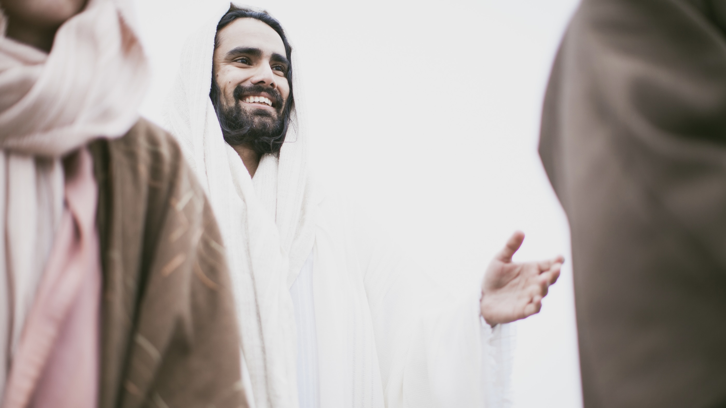

Slide 19
“Go and make disciples of all nations, baptising them in the name of the Father and of the Son and of the Holy Spirit, and teaching them to obey everything I have commanded you.”
“Go into all the world and preach the gospel to all creation. […] And these signs will accompany… drive out demons; speak in new tongues; pick up snakes; deadly poison will not hurt at all; place their hands on sick people, and they will be healed.”
“Repentance for the forgiveness of sins will be preached in [Christ’s] name to all nations, beginning at Jerusalem.”
“As the Father has sent Me, I also send you.”

Slide 20
“Go, stand in the temple courts, and tell the people all about this new life.”
(Acts 5:20)

Slide 25
‘I found this course very enjoyable and spiritual and fulfilling of my needs.’ (Tina-Louise)
‘Thank you for accompanying me during the courses and for your encouraging feedback. I have really enjoyed the courses and they have helped me a lot. I made positive lifestyle changes as I went along and reviewed things.’ (Julia)
‘I’ve learned a lot through this course. My eyes have been opened.’ (David)
‘I feel I’ve started a long journey towards understanding my faith.’ (Stephen)

Slide 26
If you cannot preach like angels
“Go, stand in the temple courts, and tell the people all about this new life.”
(Acts 5:20)

