Slide 1
Mission at Your Fingertips
Pastor Christian Salcianu Adventist Discovery Centre UK and Ireland

Slide 2
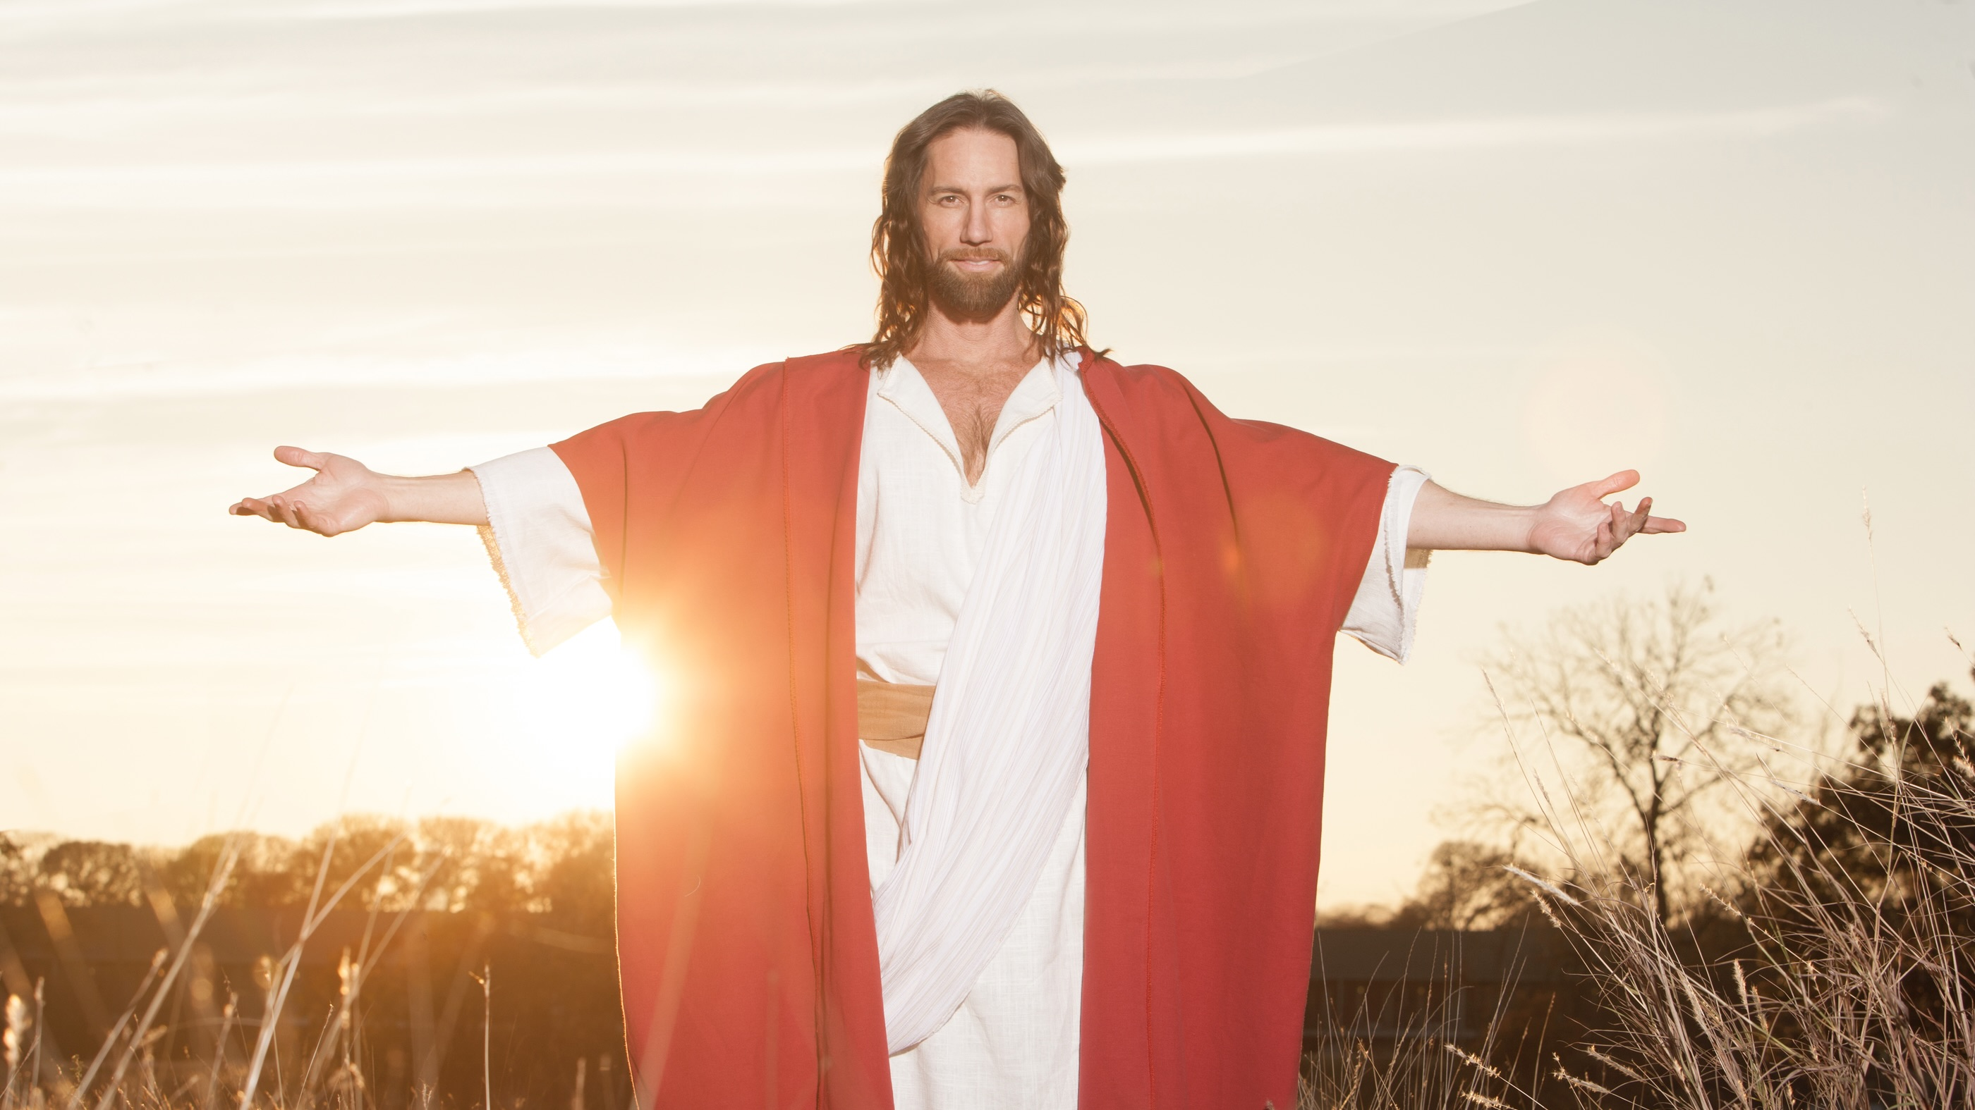

Slide 3
“The Son of Man came to seek and to save the lost.”
(Luke 19:10)

Slide 4
SEEK
SAVE

Slide 6
SEEK
SAVE

Slide 7
Adventist Discovery Centre

Slide 8
THE 4 ADC VECTORS
online and mailed courses
articles, books along with other valued digital media resources
the FreeBible programme
social network communities for interactive studies

Slide 9
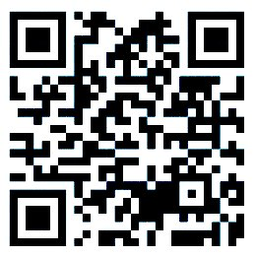
AdventistDiscoveryCentre.org

Slide 10
1. ADC COURSES
Spirituality
Jesus Christ
Faiths
Archaeology
Health
Juniors

Slide 11
20 Courses

Slide 12
The newest one, added

Slide 14
2. ADC RESOURCES
Articles
Booklets
Books
Audio
Video
Hope Channel

Slide 15
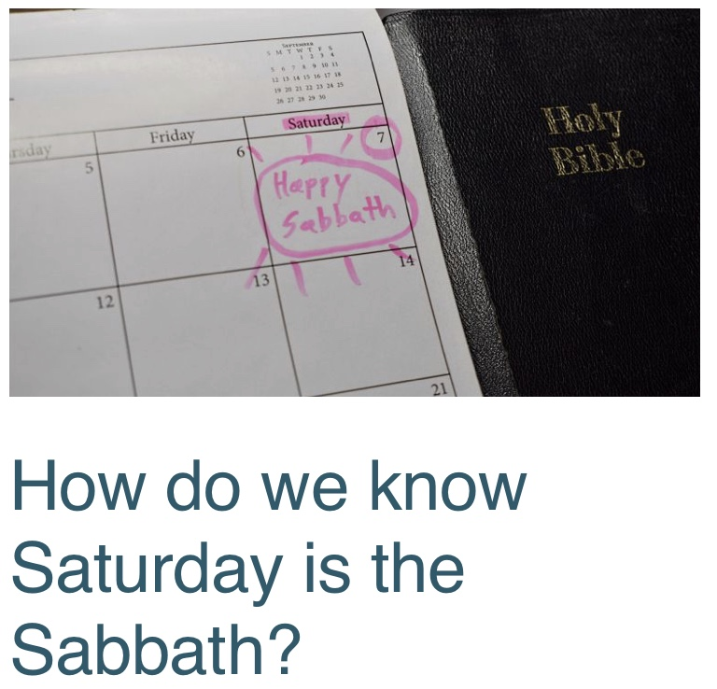

Slide 16
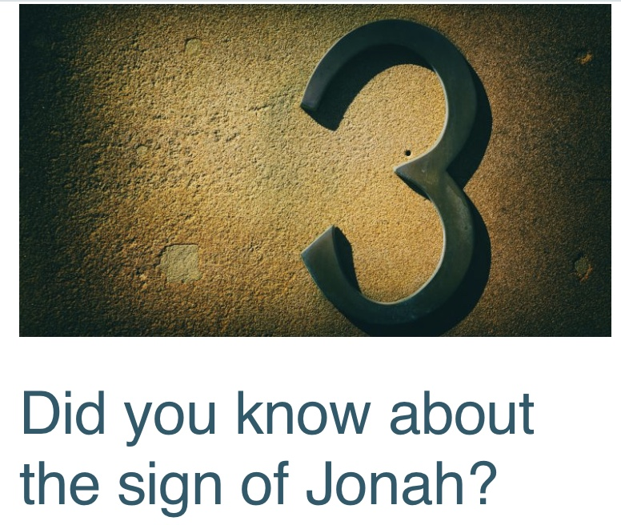
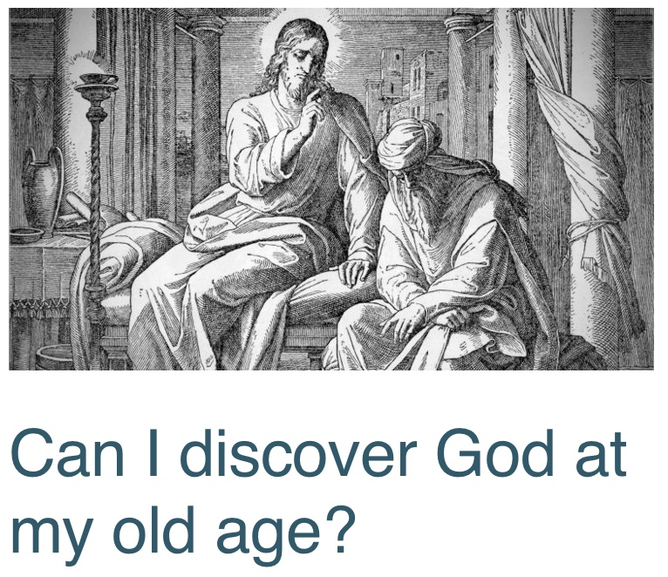

Slide 18
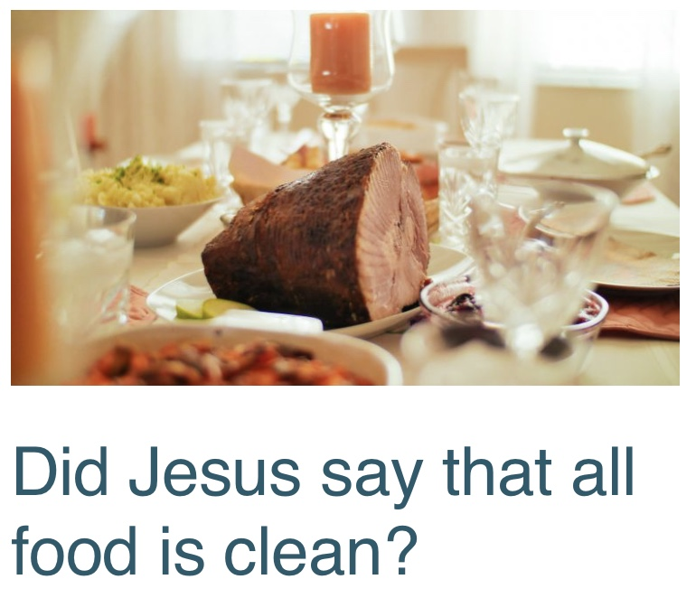

Slide 23
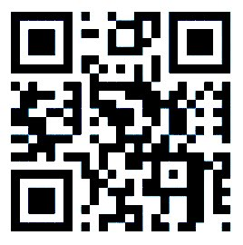
3. FREEBIBLE

Slide 24
3. FREEBIBLE
FreeBible is a website, www.freebible.uk where a user completes some online quizzes.
10 quizzes done get your free Bible!
All 28 quizzes done get a free Desire of Ages (illustrated)

Slide 28
4. ADC COMMUNITIES
Social network communities for interactive studies:
Churches
Small groups
Communities

Slide 29
WAYS to interact
Small group in the church
Weekly prayer and Bible study meetings
Baptismal classes
Discipleship / Pathfinders / Continual education
Campaign in the community
Mission wide study meetings (Zoom)

Slide 30
20 Courses

Slide 31
Those who are partaker of the grace of Christ will be ready to make any sacrifice, that others for whom He died may share the heavenly gift.
They will do all they can to make the world better for their stay in it.
This spirit is the sure outgrowth of a soul truly converted.

Slide 32
No sooner does one come to Christ than there is born in his heart a desire to make known to others what a precious friend he has found in Jesus.
The saving and sanctifying truth cannot be shut up in his heart.
(Ellen G. White, Steps to Christ)

Slide 33
Journey
Advertisement
Student registration
Completion of FreeBible / Course
Follow up with other courses (resources)
Questions about church
Visit to/from the church

Slide 36
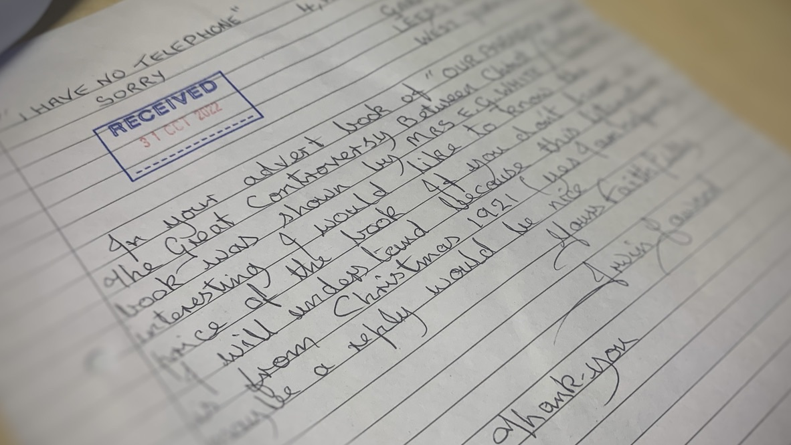

Slide 42
If you cannot preach like angels
“Go, stand in the temple courts, and tell the people all about this new life.”
(Acts 5:20)

